Slide 1
FWD Project
TOGAF 9 – Core Diagrams
Class Diagram
Phase C – Information Systems Architectures

Slide 2
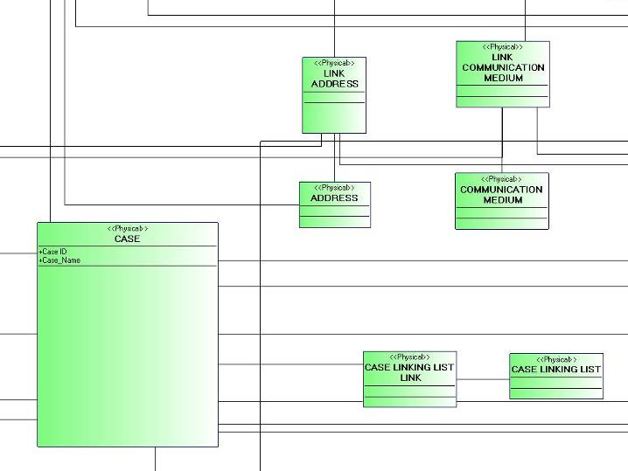
Class Diagram

Slide 3
Class Diagram
Analysis Model
Design Model
<<trace>>
Analysis Package
Design Subsystem
Analysis Class
Use-Case
Realization
Design Class
Interface
Use-Case Realization – Design

Slide 4
Class Diagram
XMLLoader
XMLHandler
Fattura
MultiThreadProcessingManager
ThreadUnit
1: //loadXmlData
1.1 //startElaboration(data)
2: //run(data)
2.1: //parse(data)
2.1.1: //new

